Slide 1

HR
ANALYTICS
EMPLOYEE ATTRITION
AND
PERFORMANCE
ANALYSIS
Project Owner : Shaboni Roy

Slide 2


CONTENTS
INTRODUCTION
GOALS AND KPI’S
RECOMMENDED
ANALYSIS
CONCLUSION

Slide 3

INTRODUCTION
Background : An overview of HR data which consist of 1413 rows and 38 columns is given in this report. Before visualization we analyse the data properly to drive the insights from data which will help us to find out what are the steps we should take to minimize the attrition rate.
Problem : The company has been facing the attrition issue which is impacting there value in the market and company is also losing its performance to address this issue, its very essential to know the reasons behind the attrition and find out insights to attract new as well as existing employees.

Slide 4
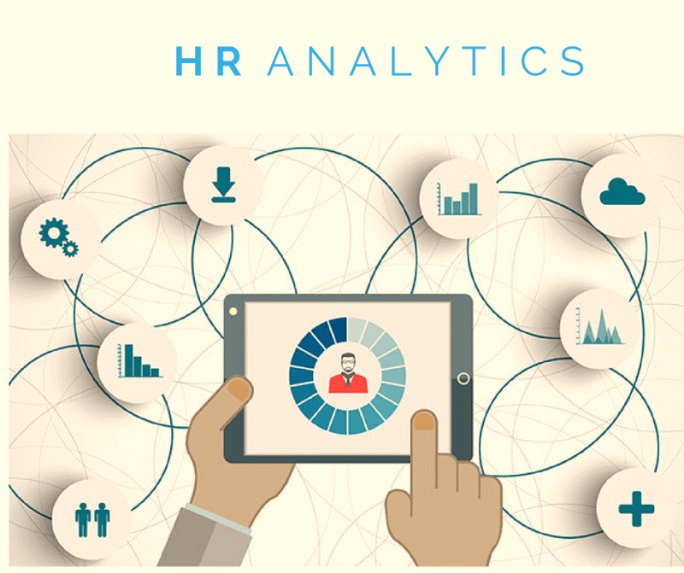
GOALS AND KPI’S
GOALS :
Optimization of employees performance
Understand employees need
Improve employee satisfaction
Monitor attrition rate
Develop retention strategies.
KPI’S :
Total number of employees
Attrition rate
Average salary
Count of employees having
attrition
Average age of employees
Average years of employees working in the company

Slide 5

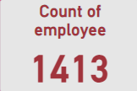
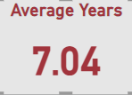
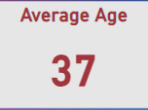
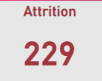

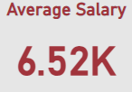
RECOMMENDED ANALYSIS
Total number of employees = 1413
Out of total employees, 229 faced attrition
The Attrition Rate is 16.21%.
The average age is 37
The average number of years of employee working in the company is 7.04.
The average salary is 6.52K.

Slide 6
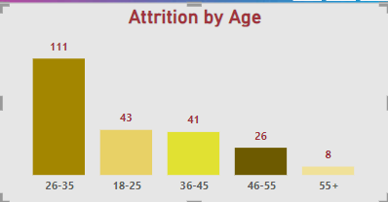
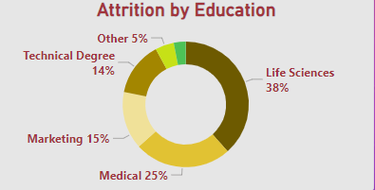
In which age group is the attrition level high?
Ans) 26 to 35 is the age group which has the highest attrition level.
Which education field has the more attrition rate?
Ans) Life Sciences with 38% of the total has the more attrition rate.

Slide 7
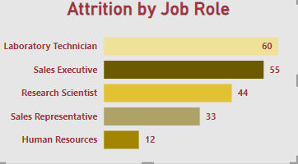
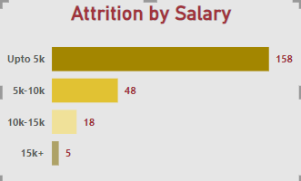
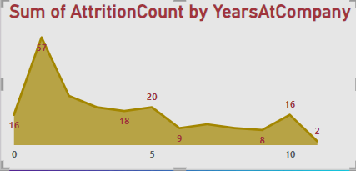
In which job role attrition level is highest?
Ans) Laboratory Technician has the highest attrition level.
Which salary range has the highest attrition level?
Ans) Salary upto 5000 has the highest attrition level.
Where is the attrition level the highest in terms of employee years at the company?
Ans) 1st year has the highest attrition level in the company.

Slide 8

CONCLUSION
HR analytics plays a crucial role in helping organizations make data-driven decisions about their human resources strategies. By analyzing key HR metrics, businesses can gain insights into employee engagement, performance, turnover and attrition. This analysis helps uncover patterns behind issues like absenteeism or the risk of employees quitting. This analysis has been done to enable the organization to enhance workforce planning, talent management and overall employee engagement by translating HR data into actionable insights.

Slide 9



THANK YOU!
shaboniroy05@gmail.com
Shaboni Roy | LinkedIn

